Slide 1







Chapter 5
Data Analysis With Python
Notes:
Good [morning/afternoon/evening], everyone!
Welcome to this exciting session on Data Analysis with Python. In today's data-driven world, the ability to analyze and derive meaningful insights from data is an incredibly valuable skill. Whether you're looking to pursue a career in data science, improve your research capabilities, or simply enhance your problem-solving toolkit, understanding data analysis is key.
Python, with its powerful libraries and easy-to-understand syntax, has become one of the most popular programming languages for data analysis. Today, we'll dive into how Python can be used to process, visualize, and interpret data effectively.
Throughout this session, we'll cover:
1. Introduction to Data Analysis: Understanding what data analysis is and why it's important.
2. Python Fundamentals: A brief overview of Python basics to ensure everyone is on the same page.
3. Key Libraries: Introduction to essential Python libraries like NumPy, pandas, and Matplotlib that are commonly used in data analysis.
4. Data Manipulation: Techniques for cleaning and transforming data to make it suitable for analysis.
5. Data Visualization: Creating graphs and charts to visualize data patterns and trends.
6. Practical Examples: Hands-on examples and exercises to apply what we've learned.
By the end of this session, you'll have a solid foundation in data analysis with Python and be equipped with the tools to start your own data projects. So, let's get started and unlock the power of data with Python!

Slide 2

Learning Objectives
You will learn in this lesson:
Retrieve data from multiple sources
Perform Exploratory Data Analysis
Handle categorical and ordinal features
Will get a practical exposure two data analysis tools like numPy, Matplotlib and Pandas.
We'll get practical explosion on web scrapping by Python
Notes:
Learning Objective
-------------------------------------------------------------------------------------------------------------------------------------------------------------------------------
In this slide, Trainer would be making understand that – What are the benefits of the topics, What will be objective. How the topic will be benefitted in order to develop the skill.
---------------------------------------------------
Learning Objective
The learning objectives include: retrieving data from multiple sources (such as databases and APIs), performing Exploratory Data Analysis (EDA), effectively handling categorical and ordinal features, gaining practical exposure to data analysis tools like NumPy, Matplotlib, and Pandas for data manipulation and visualization, and acquiring skills in web scraping using Python for data extraction from websites. These objectives collectively aim to develop proficiency in acquiring, exploring, and analyzing data using diverse methods and tools in Python.

Slide 3
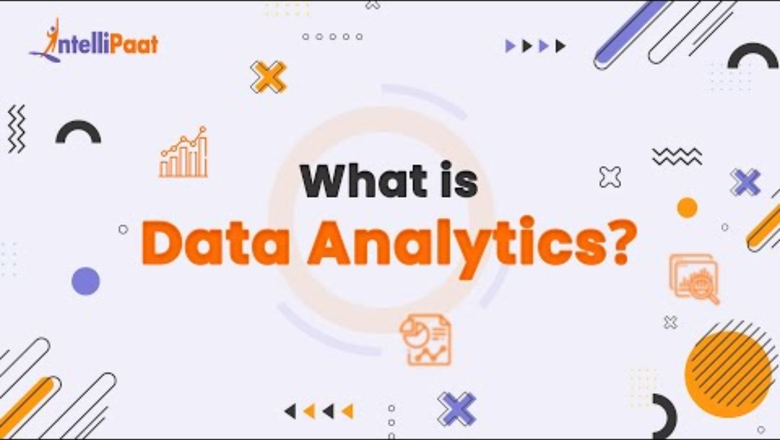
Source :
https://www.youtube.com/watch?v=37x5dKW-X5U
Notes:
Let's try to understand the importance of data analysis from this video.

Slide 4

Introduction to Data Science
Data science is a multidisciplinary field that uses scientific methods, processes, algorithms, and systems to extract knowledge and insights from structured and unstructured data. It combines elements of mathematics, statistics, computer science, and domain expertise to understand complex phenomena and make data-driven decisions.
Source :
https://miro.medium.com/v2/format:webp/1*Owa2rsDG6Rwv1IM_RdsL3A.gif
Notes:
Introduction to Data Science
---------------------------------------------------------------------------------------------------------------------------------------------------------------------
Trainer will be briefing on Data Science and telling its importance
--------------------------------------------------------------------------------------------------------
In the "Introduction to Data Science" slide, the trainer should cover the following key points:
1. Definition of Data Science: Explain what data science is, highlighting its interdisciplinary nature, combining statistics, computer science, and domain expertise to extract insights from data.
2. Importance and Applications: Discuss the significance of data science in today’s data-driven world and provide examples of its applications in various fields such as healthcare, finance, marketing, and technology.
3. Data Science Process: Outline the typical data science workflow, including stages like data collection, data cleaning, data exploration, data modeling, and data interpretation.
4. Key Components: Introduce the essential components of data science: data, algorithms, and computing power. Explain how these components interact to create meaningful insights.
5. Tools and Technologies: Provide an overview of common tools and technologies used in data science, such as Python, R, SQL, and various machine learning libraries.
6. Skills Required: Highlight the skills necessary for a data scientist, including statistical analysis, programming, data visualization, and domain knowledge.
7. Challenges in Data Science: Discuss some of the common challenges faced in data science projects, such as data quality issues, scalability, and the need for interdisciplinary collaboration.
8. Future of Data Science: Briefly touch on emerging trends and the future of data science, including the impact of big data, artificial intelligence, and advancements in computing technologies.

Slide 5
Understanding the Data Analysis Process
The data analysis process involves several key steps to transform raw data into actionable insights:
Modeling
Feature Engineering
Exploratory Data Analysis (EDA)
Data Cleaning
Data Collection
Notes:
Understanding the Data Analysis Process ------------------------------------------------------------------------------------------------------------------------------------------------------------------------------
In the "Understanding the Data Analysis Process" slide, the trainer should explain each step in detail to ensure students grasp the entire workflow:
1. Data Collection: Discuss the importance of gathering accurate and relevant data from various sources such as databases, APIs, files, or sensors. Explain different methods of data collection and the tools commonly used.
2. Data Cleaning: Explain the preprocessing steps required to prepare data for analysis, including handling missing values, removing duplicates, and ensuring consistent formatting. Emphasize the importance of data quality for reliable analysis.
3. Exploratory Data Analysis (EDA): Describe how EDA helps in understanding the data by using visual and statistical techniques. Show examples of plots and statistics that reveal patterns, relationships, and distributions within the data.
4. Feature Engineering: Explain the process of creating new features or transforming existing ones to improve model performance. Provide examples of common feature engineering techniques and their impact on modeling.
5. Modeling: Introduce the concept of building predictive or descriptive models using machine learning algorithms. Explain the different types of models (e.g., regression, classification, clustering) and how they are applied.
6. Evaluation: Discuss the methods used to assess model performance, such as cross-validation, accuracy, precision, recall, and F1 score. Explain the importance of iterating on models to improve their accuracy and reliability.
7. Visualization and Interpretation: Highlight the significance of presenting findings visually through charts, graphs, and dashboards. Explain how to interpret these visualizations to derive actionable insights and make data-driven decisions.
By covering these points, the trainer will provide a comprehensive understanding of the data analysis process, from raw data collection to deriving meaningful insights.
------------------------------------------------------------------------------------------------------------------------------------------------------------------------------
For Trainer Reference:-
The data analysis process involves several key steps to transform raw data into actionable insights:
Data Collection: Gathering data from various sources, including databases, APIs, files, or sensors.
Data Cleaning: Preprocessing and preparing data by handling missing values, removing duplicates, and formatting data for analysis.
Exploratory Data Analysis (EDA): Exploring data visually and statistically to understand patterns, relationships, and distributions.
Feature Engineering: Creating new features or transforming existing ones to improve model performance.
Modeling: Building predictive or descriptive models using machine learning algorithms.
Evaluation: Assessing model performance and iterating to improve accuracy and reliability.
Visualization and Interpretation: Presenting findings visually and deriving actionable insights.

Slide 6
Installing and Verifying Data Science Python Packages
To start with data science in Python, it's essential to install and verify key packages:
Installation: Use pip (Python's package installer) to install packages such as numpy, pandas, matplotlib, and scikit-learn:
pip install numpy pandas matplotlib scikit-learn
Verification: Ensure packages are correctly installed by importing them into Python:
import numpy
import pandas
import matplotlib
import sklearn
Notes:
Installing and Verifying Data Science Python Packages:
To start with data science in Python, it's essential to install and verify key packages:
Installation: Use pip (Python's package installer) to install packages such as numpy, pandas, matplotlib, and scikit-learn:
pip install numpy pandas matplotlib scikit-learn
Verification: Ensure packages are correctly installed by importing them into Python:
import numpy
import pandas
import matplotlib
import sklearn
These packages provide essential functionalities for data manipulation, analysis, visualization, and machine learning in Python, forming the foundation for data science projects.

Slide 7

Introduction
Exploratory data analysis utilizes graphics and visualization for data exploration. This course will make you understand the importance of Exploratory data analysis in ML.
Source :
https://miro.medium.com/v2/resize:fit:720/format:webp/0*cmWRXafuUmoOQrlq.gif
Notes:
Exploratory data analysis (EDA) is key in ML as it uses visual methods to discover patterns and insights. This course highlights EDA's role in understanding data before applying ML algorithms.

Slide 8
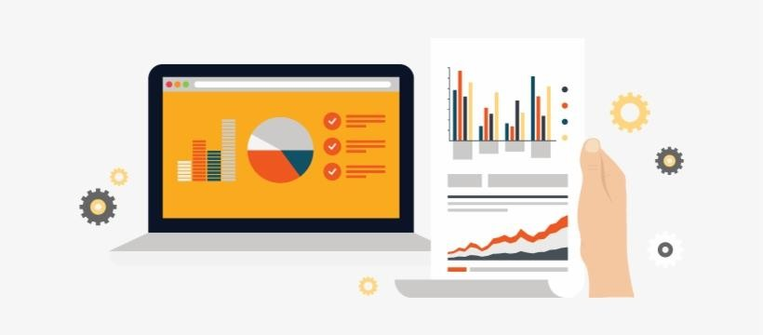
What is EDA?
Technically, The primary motive of EDA is to
Examine the data distribution
Handling missing values of the dataset
Handling the outliers
Removing duplicate data
Encoding the categorical variables
Normalizing and Scaling
Notes:
Hello everyone, today we're going to dive into the concept of Exploratory Data Analysis, or EDA for short. EDA is a crucial step in the data analysis process, allowing us to understand the underlying patterns and characteristics of our data before we move on to more complex modeling and analysis.
Technically, the primary motive of EDA is multifaceted. First and foremost, it helps us to examine the data distribution. By understanding how our data is spread out, we can make more informed decisions about the types of analyses that are appropriate.
Next, EDA involves handling missing values in the dataset. Missing data can skew our results, so it's important to identify and address any gaps we find.
Another critical aspect of EDA is handling outliers. Outliers are data points that differ significantly from other observations and can have a disproportionate impact on our analysis. Identifying and deciding how to handle these outliers is a key step in ensuring the accuracy of our results.
We also need to consider duplicate data. Removing duplicates is essential because repeated data points can bias our analysis and lead to incorrect conclusions.
Additionally, encoding categorical variables is a necessary step in EDA. Many machine learning algorithms require numerical input, so we need to convert categorical data into a format that can be processed.
Finally, normalizing and scaling our data is important. This step ensures that our data is on a similar scale, which can improve the performance of many algorithms.
By systematically addressing these tasks, EDA helps us to clean and prepare our data, making it ready for more advanced analysis and modeling."

Slide 9
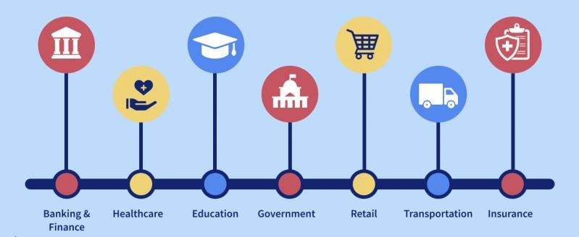
Importance of EDA
Source :
https://www.interviewbit.com/blog/applications-of-big-data/
Notes:
EDA serves as the foundation for any data analysis project. By exploring and understanding the data upfront, we can uncover initial insights that guide the entire analytical process.
let's explore some of its practical applications across various domains.
Business Intelligence and Decision-Making: EDA helps businesses analyze sales data, customer feedback, and market trends. By understanding these data patterns, companies can make informed decisions about product development, marketing strategies, and customer service improvements.
Healthcare Analytics: In healthcare, EDA is used to analyze patient data, identify trends in disease prevalence, and evaluate the effectiveness of treatments. This analysis can lead to improved patient outcomes and more efficient healthcare delivery.
Finance and Risk Management: Financial institutions use EDA to assess risk, detect fraud, and optimize investment strategies. By exploring historical financial data, analysts can identify patterns that indicate potential risks or opportunities.
Marketing Analysis: EDA allows marketers to analyze campaign performance, understand customer behavior, and segment target audiences. This insight helps in designing more effective marketing campaigns and improving customer engagement.
Retail and E-commerce: In retail, EDA is used to analyze sales data, inventory levels, and customer purchase patterns. This helps retailers optimize inventory management, pricing strategies, and promotional activities.
Social Media Analysis: EDA helps in analyzing social media data to understand user engagement, sentiment, and trends. Businesses and researchers can use these insights to enhance their social media strategies and monitor brand reputation.
Manufacturing and Quality Control: In manufacturing, EDA is used to analyze production data, monitor equipment performance, and detect defects. This helps improve product quality, reduce downtime, and enhance operational efficiency.
Sports Analytics: EDA is applied in sports to analyze player performance, game statistics, and injury patterns. Teams and coaches use these insights to develop strategies, enhance training programs, and make data-driven decisions.
Environmental Studies: Researchers use EDA to analyze environmental data, such as climate patterns, pollution levels, and biodiversity metrics. This helps in understanding ecological changes and developing strategies for conservation and sustainability.
Education Analytics: In education, EDA is used to analyze student performance data, identify factors affecting learning outcomes, and develop personalized learning plans. This helps in improving educational strategies and student success rates.
In summary, EDA is a versatile tool that can be applied in numerous fields to uncover valuable insights, inform decision-making, and drive improvements. Its ability to provide a comprehensive understanding of data makes it indispensable in today's data-driven world."

Slide 10
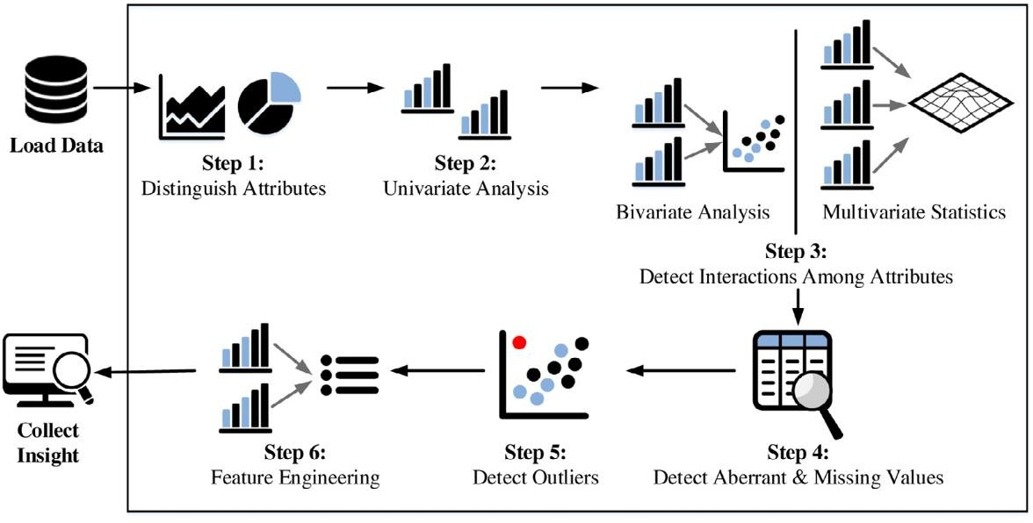
A Typical EDA Process
Source :
https://devopedia.org/exploratory-data-analysis
Notes:
Let's walk through a typical Exploratory Data Analysis (EDA) process. Understanding the steps involved will help us systematically explore and prepare our data for further analysis.
Data Collection and Loading: The first step is to collect and load the data. This could involve importing data from various sources such as databases, spreadsheets, or web APIs. Ensuring the data is in a usable format is crucial at this stage.
Initial Data Inspection: Once the data is loaded, we perform an initial inspection to understand its structure. This involves looking at the data types, number of rows and columns, and getting a general sense of the content. Common commands in programming languages like Python include head(), info(), and describe().
Data Cleaning: The next step is data cleaning. This involves handling missing values, removing duplicate records, and correcting any inconsistencies. Techniques such as imputation, deletion, or substitution can be used to manage missing data.
Data Transformation: After cleaning, we transform the data as needed. This might include encoding categorical variables into numerical values, normalizing or scaling features, and creating new variables through feature engineering. These transformations help prepare the data for analysis and modeling.
Exploratory Visualization: Visualization is a powerful tool in EDA. We create various plots such as histograms, box plots, scatter plots, and correlation matrices to visualize the data distribution, identify patterns, and detect outliers. Libraries like Matplotlib, Seaborn, and Plotly are commonly used for this purpose.
Summary Statistics: Calculating summary statistics helps us understand the central tendency, dispersion, and shape of the data distribution. Key metrics include mean, median, mode, standard deviation, and percentiles. These statistics provide a numerical summary of the data.
Outlier Detection and Handling: Identifying and handling outliers is crucial as they can significantly affect our analysis. Outliers can be visualized using box plots or scatter plots, and handled through techniques such as capping, transformation, or removal.
Bivariate and Multivariate Analysis: In this step, we explore the relationships between variables. Bivariate analysis examines the relationship between two variables using techniques like correlation analysis and scatter plots. Multivariate analysis looks at interactions between multiple variables using techniques like pair plots and heatmaps.
Hypothesis Generation: Based on the insights gained from the exploratory analysis, we generate hypotheses about the data. These hypotheses guide further analysis and modeling efforts. For example, we might hypothesize that a certain feature significantly impacts the target variable.
Documentation and Reporting: Finally, we document our findings and create reports or dashboards to communicate the insights. Clear documentation and visualizations help stakeholders understand the data and the conclusions drawn from the analysis.
In summary, a typical EDA process involves a series of systematic steps aimed at thoroughly understanding and preparing the data. This process ensures that we have a clean, well-understood dataset ready for more advanced analysis and modeling."

Slide 11


Activity Time: Data Analysis Steps Involved in Customer Data Analysis
Scenario: Employee Data Analysis
Question: You have access to a dataset of employee information, including EmployeeID, Department, Salary, and YearsAtCompany. Explain the EDA process you would undertake to understand this data.
Notes:
Solution: Employee Data Analysis
Step 1: Understanding the Data
Familiarize with the Dataset: Begin by examining the structure of the dataset, understanding the meaning of each column (EmployeeID, Department, Salary, YearsAtCompany), and identifying the data types (e.g., numerical, categorical).
Step 2: Data Cleaning
Identify and Handle Missing Values: Check for missing values in the dataset. For Salary and YearsAtCompany, consider using imputation methods such as filling with the mean or median values. For Department, missing values could be imputed using the mode (most frequent value) or domain knowledge.
Remove Duplicates: Ensure there are no duplicate rows in the dataset, especially for unique identifiers like EmployeeID.
Step 3: Descriptive Statistics
Calculate Basic Statistics: Compute summary statistics such as mean, median, minimum, maximum, and standard deviation for Salary and YearsAtCompany. This provides a basic understanding of the central tendency and spread of the data.
Step 4: Data Visualization
Salary Distribution: Create histograms or box plots to visualize the distribution of salaries across the entire dataset. This helps in identifying the spread and any potential outliers.
Department-wise Salary Distribution: Use box plots to compare salary distributions across different departments. This can highlight disparities or variances in salaries among departments.
Years at Company: Plot histograms or bar charts to visualize the distribution of years employees have been at the company. This can reveal trends in employee retention and tenure.
Correlation Analysis: Generate scatter plots to explore the relationship between Salary and YearsAtCompany. Calculate the correlation coefficient to quantify the strength of this relationship.
Step 5: Insights and Reporting
Interpret Findings: Summarize the insights gained from the descriptive statistics and visualizations. For example, identify which departments have higher average salaries, detect any patterns related to employee tenure and salary, and note any significant outliers.
Prepare a Report: Compile the findings into a comprehensive report. Include visualizations and key statistics, and provide interpretations and recommendations based on the analysis. For instance, suggest addressing any detected salary disparities or developing strategies for improving employee retention.

Slide 12
EDA Techniques
EDA
Quantitative Technique
Graphical
Notes:
Now, let's explore the two main categories of techniques used in Exploratory Data Analysis (EDA): Quantitative and Graphical techniques. Each plays a crucial role in understanding and interpreting our data.

Slide 13
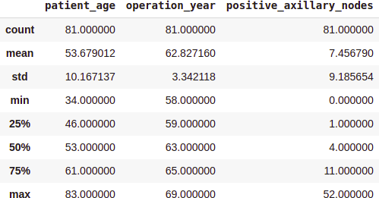
EDA: Quantitative Technique
Quantitative techniques in Exploratory Data Analysis (EDA) involve using statistical measures and methods to gain insights into data distribution, relationships, and patterns.
Source :
https://www.analyticsvidhya.com/blog/2021/08/exploratory-data-analysis-and-visualization-techniques-in-data-science/
Notes:
Quantitative Techniques:
Quantitative techniques involve numerical and statistical methods to summarize and describe the main features of a dataset.
Summary Statistics: Summary statistics provide a quick overview of the dataset's key characteristics. Common metrics include:
Mean: The average value of the data.
Median: The middle value when the data is ordered.
Mode: The most frequently occurring value.
Standard Deviation: Measures the dispersion or spread of the data.
Variance: The average squared deviation from the mean.
Percentiles: Values below which a certain percentage of the data falls.
Correlation Analysis: This technique measures the relationship between two numerical variables. The Pearson correlation coefficient is often used to quantify linear relationships, with values ranging from -1 (perfect negative correlation) to +1 (perfect positive correlation).
Hypothesis Testing: Statistical tests such as the t-test, chi-square test, and ANOVA help determine if there are significant differences between groups or relationships between variables.
Distribution Analysis: Analyzing the distribution of data points helps understand the data's shape, spread, and central tendency. Quantitative measures include skewness and kurtosis, which describe the asymmetry and peakedness of the distribution, respectively.
Outlier Detection: Identifying outliers is critical as they can heavily influence the results. Techniques include calculating Z-scores, where values beyond a certain threshold (e.g., ±3) are considered outliers, and the Interquartile Range (IQR) method, where outliers are values lying beyond 1.5 times the IQR from the quartiles.

Slide 14
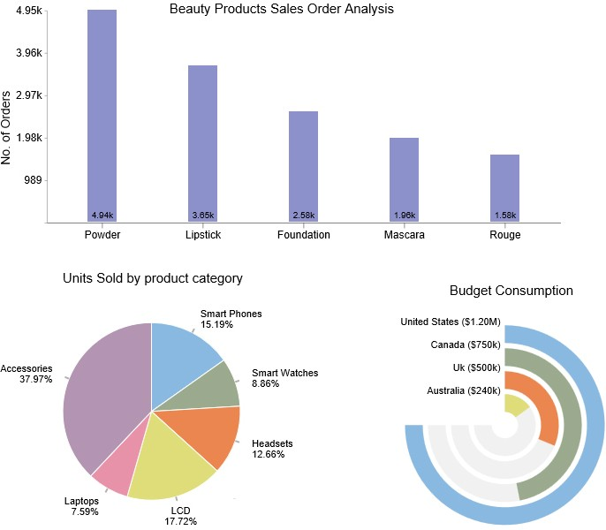
EDA: Graphical Technique
Graphical techniques in Exploratory Data Analysis (EDA) involve creating visual representations of data to uncover patterns, trends, and relationships.
Source :
https://ppcexpo.com/blog/wp-content/uploads/2022/01/exploratory-data-analysis-1.jpg
Notes:
Graphical Techniques:
Graphical techniques involve visual representations of the data, making it easier to detect patterns, trends, and outliers.
Histograms: Histograms display the frequency distribution of a single numerical variable. They help us understand the shape and spread of the data.
Box Plots: Box plots summarize the distribution of a variable and highlight outliers. They show the median, quartiles, and potential outliers in the data.
Scatter Plots: Scatter plots visualize the relationship between two numerical variables. They are useful for detecting correlations, clusters, and outliers.
Bar Charts: Bar charts are used to compare the frequency or count of categorical data. They provide a clear visual comparison between different categories.
Heatmaps: Heatmaps visualize the correlation matrix or other metrics across variables using color gradients. They are effective for showing relationships and patterns between multiple variables.
Pair Plots: Pair plots (or scatterplot matrices) display scatter plots for all pairs of numerical variables in a dataset. They help visualize relationships and interactions between variables.
Line Graphs: Line graphs are used to visualize trends over time or ordered data points. They are particularly useful for time series analysis.
Violin Plots: Violin plots combine the features of box plots and density plots, showing the distribution and probability density of the data across different categories.
Density Plots: Density plots smooth the data distribution using a kernel density estimate, providing a continuous probability distribution visualization.
Q-Q Plots: Quantile-Quantile (Q-Q) plots compare the quantiles of the data distribution to a theoretical distribution (e.g., normal distribution) to assess whether the data follows the expected distribution.
Conclusion:
Both quantitative and graphical techniques are essential components of EDA. Quantitative techniques provide precise numerical summaries and statistical tests, while graphical techniques offer intuitive visual insights into the data. Together, they form a comprehensive approach to exploring and understanding data, setting the stage for more advanced analysis and modeling.

Slide 15

NumPy
NumPy is an open-source Python library used for working with arrays.
NumPy stands for Numerical Python.
The NumPy array is a data structure that efficiently stores and accesses multidimensional arrays.
NumPy is a Python library and is written partially in Python, but most of the parts that require fast computation are written in C or C++.
Source :
https://en.wikipedia.org/wiki/NumPy
Notes:
"Now, let's talk about NumPy, an essential tool for data analysis and scientific computing in Python.
Introduction to NumPy: NumPy is an open-source Python library widely used for working with arrays. It is a fundamental package for numerical computing in Python, providing support for large, multi-dimensional arrays and matrices, along with a collection of mathematical functions to operate on these arrays efficiently.
What NumPy Stands For: NumPy stands for 'Numerical Python'. It is designed to handle numerical data efficiently and is a cornerstone of the scientific Python ecosystem.
NumPy Arrays: The core of NumPy is the array object, known as ndarray. The NumPy array is a powerful data structure that efficiently stores and accesses multidimensional arrays. Unlike Python's built-in lists, NumPy arrays are more compact, faster, and can handle large datasets more efficiently.
Efficiency of NumPy: NumPy achieves its high performance through several mechanisms:
Optimized C and C++ Code: Although NumPy is a Python library, it is written partially in Python, but most of the parts that require fast computation are written in C or C++. This allows NumPy to perform operations much faster than pure Python.
Vectorization: NumPy takes advantage of vectorized operations, which apply a function to an entire array, element-wise, without the need for explicit loops. This not only makes the code more concise and readable but also significantly speeds up computation.
Conclusion:
In summary, NumPy is an indispensable tool for anyone working with numerical data in Python. Its ability to handle large datasets efficiently, combined with its powerful array operations, makes it a go-to library for data scientists, engineers, and researchers. Understanding and utilizing NumPy is a crucial skill in the field of data analysis and scientific computing.

Slide 16
Classroom Activity
Lab 19: Practicing NumPy
Solution: GitHub Link
Notes:
Lab 19 - In this lab, we're diving into NumPy, a fundamental package for scientific computing in Python. We'll explore its array objects, practice data manipulation, and perform complex mathematical operations. Our goal is to gain proficiency in NumPy to enhance our data analysis and machine learning skills. Let's get started!

Slide 17
Self_Practice
Lab 19 : Implementing Numpy Concepts in Python
Solution: GitHub Link
Notes:
Lab 19 – Implementing Numpy Concepts in Python

Slide 18
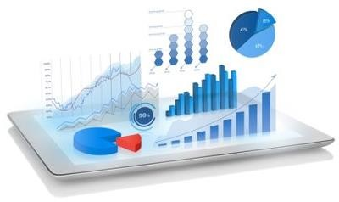
What is Data Visualization?
Data visualization deals with a visual representation of data and is part of data analysis. It is the process of translating data into a chart, graph, or other visual components.
Source :
https://www.techfunnel.com/wp-content/uploads/2020/10/data-visualization.png
Notes:
In this Slide, we're diving into Data visualization that transforms complex data into understandable visuals like charts and graphs. It's a key part of data analysis, helping to convey information clearly and effectively. By presenting data visually, it becomes easier to see patterns, trends, and outliers, which aids in making informed decisions based on the data presented.

Slide 19




Plotting and Visualization
Data visualization packages and tools are required to provide an accessible way to analyse massive amounts of information and understand trends and patterns in data.
Notes:
Data visualization is important for making sense of large datasets. By installing and importing the specialized packages such as matplotlib,plotly,pandas,seaborn, we can create graphs and charts that make it easier to spot trends and patterns. This process helps transform complex data into clear, understandable visuals, aiding in better decision-making and analysis.

Slide 20

Matplotlib
Matplotlib is one of the most popular Python packages used for data visualization. It is a cross-
platform library for making 2D plots from data in arrays.
Notes:
Matplotlib is a widely-used Python library, essential for creating 2D visualizations. With it, you can transform data into clear plots and graphs, making analysis easier. It supports various output formats, is highly customizable, and integrates well with other libraries, making it a go-to tool for data scientists and researchers.

Slide 21
Classroom Activity
Lab 20: Practicing Matplotlib
Solution: GitHub Link
Notes:
Lab 20 - In this lab, we're exploring Matplotlib, a powerful tool for creating visualizations in Python. We'll learn how to plot data, customize charts, and interpret results. Our focus is on practical application, ensuring you can effectively communicate data insights through visual representation. Let's dive into the world of data visualization together.

Slide 22
Self_Practice
Lab 20: Implementing Matplotlib Concepts in Python
Solution: GitHub Link
Notes:
Lab 20 – Implementing Matplotlib Concepts in Python

Slide 23

Seaborn
Seaborn is a Python data visualization library based on matplotlib. It provides a high-level interface
for drawing attractive and informative statistical graphics.
Notes:
Seaborn simplifies data visualization in Python, offering a high-level interface for creating attractive, statistical charts. It enhances matplotlib's capabilities, making it easier to generate complex visuals. With Seaborn, you can present data in a more accessible and understandable way, which is crucial for data analysis and interpretation.

Slide 24
Classroom Activity
Lab 21: Practicing Seaborn
Solution: GitHub Link
Notes:
Lab 21 - In this session, we're diving into Seaborn, a powerful Python library for data visualization. We'll explore how Seaborn helps in creating informative and attractive statistical graphics. Our focus will be on its user-friendly interface that works well with pandas data structures, enhancing our data analysis and insights.

Slide 25
Self_Practice
Lab 21: Implementing Seaborn Concepts in Python
Solution: GitHub Link
Notes:
Lab 21 – Implementing Seaborn Concepts in Python

Slide 26

Pandas
Pandas is a Python library used for working with data sets (csv, json..,etc).
It has functions for
Analyzing.
Cleaning.
Exploring.
and manipulating data.
The name "Pandas" has a reference to both "Panel
Data", and "Python Data Analysis" and was created
by Wes McKinney in 2008.
Source :
https://en.wikipedia.org/wiki/Pandas_%28software%29
Notes:
Pandas is a versatile Python library, essential for data manipulation and analysis. It simplifies tasks like data cleaning, exploration, and analysis, making it easier to work with different data formats such as CSV and JSON. The name 'Pandas' is derived from 'Panel Data' and 'Python Data Analysis', reflecting its functionality.

Slide 27
Classroom Activity
Lab 22: Practicing Pandas
Solution: GitHub Link
Notes:
Lab 22 - In this Lab, we're diving into Pandas, a powerful Python library for data analysis. We'll explore its functionalities for manipulating and analyzing large datasets. By mastering Pandas, we can streamline our data processing tasks and uncover valuable insights from our research. Let's begin our journey into data science with Pandas.

Slide 28
Self_Practice
Lab 22: Implementing Pandas Concepts in Python
Solution: GitHub Link
Notes:
Lab 22 – Implementing Pandas Concepts in Python

Slide 29
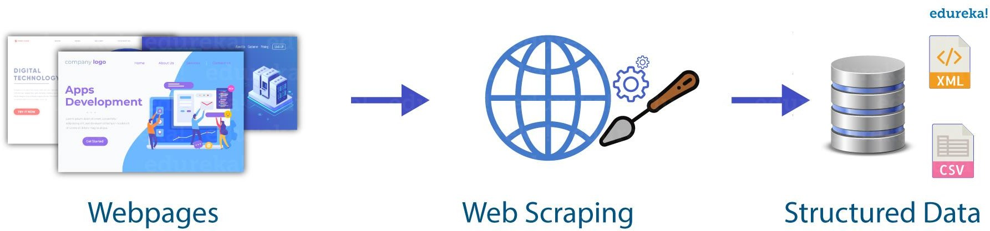
What is Web Scraping?
The method used to extract large amounts of data from websites in an automated way is called web scraping.
Source :
https://technofaq.org/posts/2019/11/myths-about-web-scraping/
Notes:
Web scraping is an automated technique for gathering data from websites quickly and efficiently, useful for analysis and storing information for future use.

Slide 30

Why is Web Scraping used?
Used in a variety of digital business that rely on data harvesting
Price Comparison
Email address gathering
Social Media Scraping
Research and Development
Job listings
Notes:
Web scraping is a powerful tool for digital businesses, enabling them to collect vast amounts of data quickly. It's commonly used for comparing prices, gathering email addresses, analyzing social media, aiding research and development, and compiling job listings. This automated process helps companies stay competitive by efficiently harvesting relevant data from the web.

Slide 31
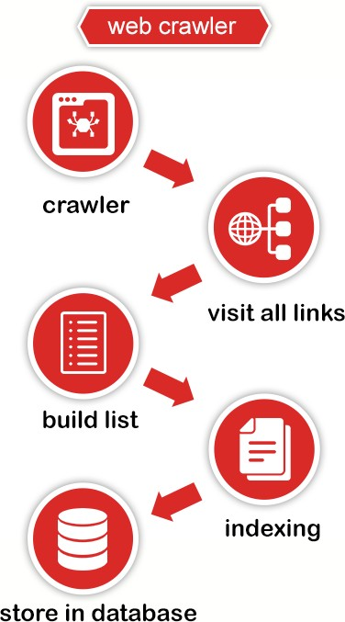
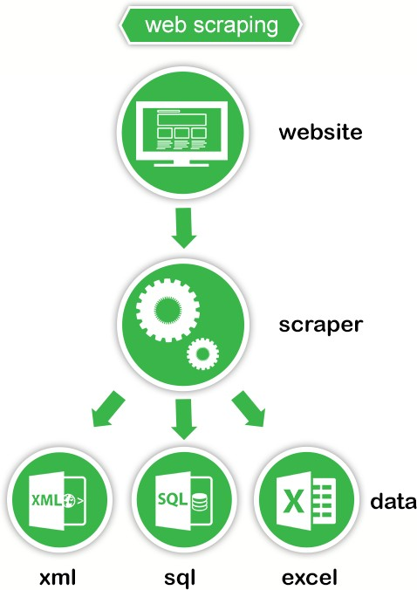
Web Scraping vs Web Crawling
Source :
http://prowebscraping.com/
Notes:
In the "Web Scraping vs Web Crawling" slide, the trainer should explain:
1. Definitions:
Web Scraping: Extracting specific data from web pages for purposes like market research and price monitoring.
Web Crawling: Systematically browsing the web to index and collect information, used by search engines.
2. Purpose:
Web Scraping: Targets specific data points for detailed analysis.
Web Crawling: Discovers and indexes a wide range of web pages.
3. Techniques and Tools:
Web Scraping: Uses HTML parsing with libraries like BeautifulSoup and Scrapy.
Web Crawling: Follows links using algorithms and tools like Scrapy and Nutch.
4. Ethical Considerations:
Both: Must respect robots.txt and legal regulations to avoid overloading servers.
5. Output:
Web Scraping: Produces structured data.
Web Crawling: Creates comprehensive web indexes.

Slide 32
Applications of Web Scraping
Machine Learning training
Tracking Competitive Pricing
Sentiment Analysis
Market Research
Content Aggregation
Monitoring Brand Value
Notes:
In the "Applications of Web Scraping" slide, the trainer should explain each application in detail:
1. Machine Learning Training:
Explanation: Web scraping is used to gather large datasets from the web, such as text or images, to train machine learning models.
2. Tracking Competitive Pricing:
Explanation: Businesses use web scraping to monitor competitors' prices and adjust their own pricing strategies accordingly.
3. Sentiment Analysis:
Explanation: Web scraping helps collect customer reviews and social media comments for sentiment analysis, providing insights into public opinion.
4. Market Research:
Explanation: Researchers use web scraping to gather data on consumer trends, product reviews, and market dynamics from various sources.
5. Content Aggregation:
Explanation: Websites aggregate content from multiple sources using web scraping to provide comprehensive information on specific topics.
6. Monitoring Brand Value:
Explanation: Companies use web scraping to track mentions of their brand across the web, analyze sentiment, and manage their online reputation effectively.
By covering these applications, the trainer will illustrate the versatility of web scraping across different domains and its impact on data-driven decision-making processes.

Slide 33
Two Types of Extract Data From a Website
01
Use the API of the website
02
Access the HTML of the webpage
Notes:
In the context of extracting data from a website, there are generally two primary methods:
1. Static Extraction (Web Scraping):
Description: Static extraction, commonly known as web scraping, involves extracting data from web pages that are rendered in HTML format.
Process: It typically involves parsing the HTML structure of a webpage, identifying specific elements (like tables, paragraphs, or images), and extracting the desired data using techniques such as XPath, CSS selectors, or regular expressions.
Use Cases: Used for tasks like price monitoring, content aggregation, and data collection for analysis.
2. Dynamic Extraction (Web API):
Description: Dynamic extraction utilizes web APIs (Application Programming Interfaces) provided by websites to access structured data directly.
Process: It involves making HTTP requests to the API endpoints, receiving responses in structured formats such as JSON or XML, and extracting the required data from these responses.
Use Cases: Ideal for scenarios where real-time data updates are needed, such as retrieving weather forecasts, financial data, or social media feeds.
These methods cater to different needs based on whether the data is readily available in the HTML content of web pages or accessed through designated APIs provided by the website. Each approach has its advantages depending on the complexity of data extraction and the requirements of the application.

Slide 34

Some libraries used for Web Scraping
BeautifulSoup
Selenium
Requests
Source :
https://www.projectpro.io/article/python-libraries-for-web-scraping/625
Notes:
Some libraries used for Web Scraping
------------------------------------------------------------------------------------------------------------------------------------------------------------------
1. Beautiful Soup:
Description: Python library for parsing HTML and XML documents, ideal for static web scraping tasks.
2. Selenium:
Description: Web testing library that automates browser interactions, used for scraping dynamic content and sites requiring JavaScript execution.
3. Requests:
Description: Python library for making HTTP requests and handling responses, commonly paired with parsing libraries like BeautifulSoup for static content extraction.

Slide 35
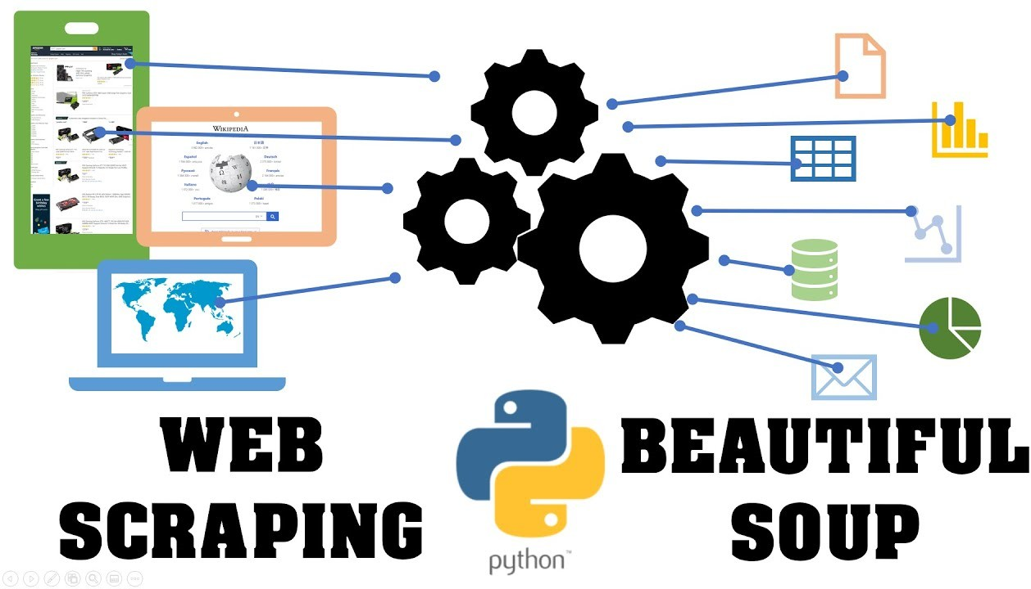
What is Beautiful Soup?
Notes:
What is Beautiful Soup?
Beautiful Soup is a Python library used for parsing HTML and XML documents.
It simplifies the extraction of data from web pages by creating a parse tree.
It's renowned for its ease of use and flexibility in handling imperfect HTML.
Integration with other libraries like Requests makes it a powerful tool for web scraping.
Installation is straightforward via pip (`pip install beautifulsoup4`).
Basic usage involves fetching a web page, parsing it with Beautiful Soup, and navigating the parse tree.
Example code snippets demonstrate extracting links, text, and specific elements from HTML.
Real-world applications include data extraction for research, monitoring, and automated testing.
Best practices emphasize respecting website policies, using headers to avoid detection, and adhering to legal guidelines.
Beautiful Soup is invaluable for developers needing efficient web scraping solutions in Python.

Slide 36
Classroom Activity
Lab 23: A Data Analysis case study using techniques of EDA.
Solution: GitHub Link
Notes:
Lab 23 - A Data Analysis case study using techniques of EDA.

Slide 37

Summary
We studied about the meaning of exploratory data analysis.
We have understood the necessity of exploratory data analysis on a new dataset.
We have used different types of tools and techniques of EDA
We have understood how to use pandas and sleep on libraries for exploratory data analysis.
Notes:
Summary
We studied about the meaning of exploratory data analysis.
We have understood the necessity of exploratory data analysis on a new dataset.
We have used different types of tools and techniques of EDA
We have understood how to use pandas and sleep on libraries for exploratory data
analysis.

Slide 38
References
Exploratory Data Analysis (EDA) - Types and Tools - GeeksforGeeks
Exploratory Data Analysis (EDA): Types, Tools, Process (knowledgehut.com)
Exploratory Data Analysis (nist.gov)
https://towardsdatascience.com/web-scraping-basics-82f8b5acd45c
https://www.analyticsvidhya.com/blog/2021/06/web-scraping-with-python-beautifulsoup-library/

Slide 39


Quiz
1) The best fit line method for data in Linear Regression?
Least Square Error
Maximum Likelihood
Logarithmic Loss
Both A and B
Answer: A
Least Square Error
Notes:
1) The best fit line method for data in Linear Regression?
A) Least Square Error
B) Maximum Likelihood
C) Logarithmic Loss
D) Both A and B
Answer is: Option A: Least Square Error
39

Slide 40
Quiz
What is the typical sequence of steps in a supervised learning project?
Data preprocessing, model training, model deployment
Model evaluation, data collection, data transformation
Model selection, data preprocessing, feature extraction
Data collection, data preprocessing, model selection
Answer: D
​Data collection, data preprocessing, model selection
Notes:
2) What is the typical sequence of steps in a supervised learning project?
A) Data preprocessing, model training, model deployment
B) Model evaluation, data collection, data transformation
C) Model selection, data preprocessing, feature extraction
D) Data collection, data preprocessing, model selection
Answer: D
​ Data collection, data preprocessing, model selection
40

Slide 41
Quiz
Machine Learning algorithms build a model base on sample data, known as_________​
Validation Data​
Training Data​
Testing Data​
Transfer Data​
​
Answer: B
Training Data​
Notes:
3) Machine Learning algorithms build a model base on sample data, known as_________​
Validation Data​
Training Data​
Testing Data​
Transfer Data​
Answer: B
Training Data​
41

Slide 42
Quiz
What is a key assumption of the Naïve Bayes classifier?
Features are independent of each other.
Features are highly correlated.
Data distribution is non-Gaussian.
Data is labeled with continuous values.
Answer: A
Features are independent of each other.
Notes:
4) What is a key assumption of the Naïve Bayes classifier?
A) Features are independent of each other.
B) Features are highly correlated.
C) Data distribution is non-Gaussian.
D) Data is labeled with continuous values.
Answer: A
Features are independent of each other.
42

Slide 43
Quiz
What type of problems is logistic regression primarily used for?
Clustering
Regression
Binary classification
Time series forecasting
Answer: C
Binary classification
Notes:
5) What type of problems is logistic regression primarily used for?
A) Clustering
B) Regression
C) Binary classification
D) Time series forecasting
Answer: C
Binary classification
43

Slide 44
Thank You

